Slide 1
Project Title
College Name and Dept
Dept
and
Student Details (Name and USN)
Guide Details
2 Section Coordinators details
Date and Time of Presentation

Slide 2

Jawaharlal Nehru New College of Engineering
Department of Computer Science & Engineering
Shivamogga - 577 204
Project Phase 2 Presentation On:
“Project Title”
Presented by:
NAME1 USN1
Project Co-ordinators: Dr. Name 1 _{B.E,M.TECH}
Assoc. Prof., Dept. of CS&E
Project Guide:
Mr. Name 1 _{B.E,M.TECH}
Asst Prof., Dept. of CS&E
&
Mrs. Name 2 _{B.E,M.TECH}
Asst Prof., Dept. of CS&E

Slide 3
Abstract
Description of your project in 5-6 sentences as a paragraph
(1 slide)

Slide 4
Outline & Content
Write the agenda of your presentation pointwise

Slide 5
Introduction
- Put Project background (2 to 3 Slides)
- Discuss Existing Problems

Slide 6
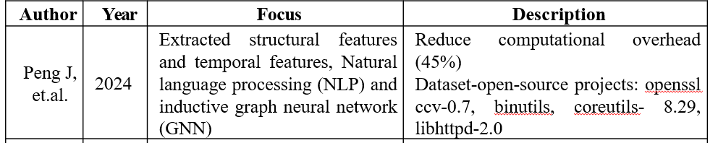
Literature Survey
Atleast 8-10 latest papers details should be included Number of slides is left to you. But make sure to include the following details for each paper.

Slide 7
Problem Statement
In a paragraph clearly write problems addressed in your project. Don’t make pointwise nor write methodology

Slide 8
Objectives
Pointwise write objectives of the project

Slide 9
System Architecture
Put a figure that represents overall system architecture clearly showing different components/blocks/modules involved
Let the figure be self explanatory so that u can avoid extra slides for explanation

Slide 10
Implementation
Algorithms/Flowcharts of each module in the project
Make atleast 4-5 slides

Slide 11
Results and Analysis/Discussions *
--put snapshots of each possible output in your project
-- If graphs have been created for analysis/visualization put them
--If no analysis is done, put discussions on the outcome you obtained from project

Slide 12
Conclusion
Provide conclusions with outputs,
Outcomes and possible future enhancements

Slide 13
References
Include at least 12-15 references

